Slide 1

Data Structure (and Algorithm)
Tanveer Ahmed Siddiqui

Slide 2

Today Covered
Searching in
  Array/List: Sorted or Unsorted
  Tree
Searching in constant Time(Hashing)
Key Components of Hashing
  Key
  Hash function
  Hash table
Criteria for choosing good hash function?
What is Collision?
Different techniques for handling Collision
  Open Addressing with Linear Probing
  Open Addressing with Quadratic Probing
  Open Addressing with Re- Hashing
  A Potential Problem with Open Addressing
  Separate Chaining
Applications
When hashing is suitable?

Slide 3
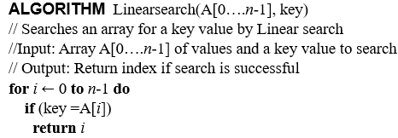
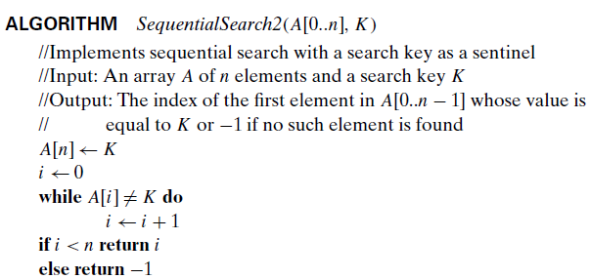
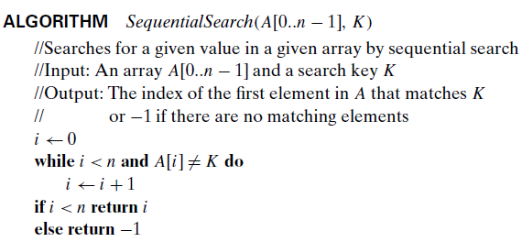
Searching
Design an algorithm that search a key K in a given array.
3,6,2,5,1,7,4 K =4
3,6,2,5,1,7,8 K =4
4,2,8,5,3,1,9 K = 4
5,2,8,4,3,1,9 K = 4
To find a key in a given array we have to perform n maximum number of comparisons

Slide 4
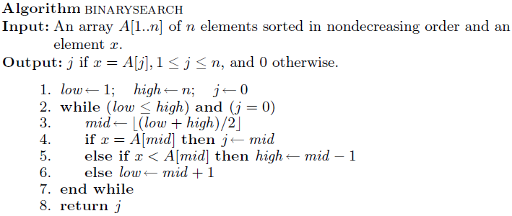
Can we reduce the number of comparison in searching? How?

Slide 5
Binary Search
Case 1: x = a[mid]
x = 10
low = 0, high = 8
mid = (0 + 8) / 2 = 4
a:
1
5
7
9
10
10
13
17
19
27
0
1
2
3
4
5
6
7
8
low
mid
high

Slide 6
Binary Search
Case 2: x > a[mid]
x = 19
low = 0, high = 8
mid = (0 + 8) / 2 = 4
new low = mid+1 = 5
a:
1
5
7
9
10
13
13
17
17
19
19
27
27
0
1
2
3
4
5
6
7
8
low
new low
high
mid

Slide 7
Binary Search
Case 3: x < a[mid]
x = 7
low = 0, high = 8
mid = (0 + 8) / 2 = 4
new high = mid-1 = 3
a:
1
1
5
5
7
7
9
9
10
13
17
19
27
0
1
2
3
4
5
6
7
8
low
new high
mid
high

Slide 8
Binary Search
val = 7
a:
1
5
7
9
10
13
17
19
27
0
1
2
3
4
5
6
7
8
a:
1
5
7
9
10
13
17
19
27
0
1
2
3
4
5
6
7
8
a:
1
5
7
9
10
13
17
19
27
0
1
2
3
4
5
6
7
8

Slide 9
Binary search: Efficiency
After 1 bisection N/2 items
After 2 bisections N/4 = N/2² items
. . .
After i bisections N/2^{i} =1 item
i = log₂ N

Slide 10
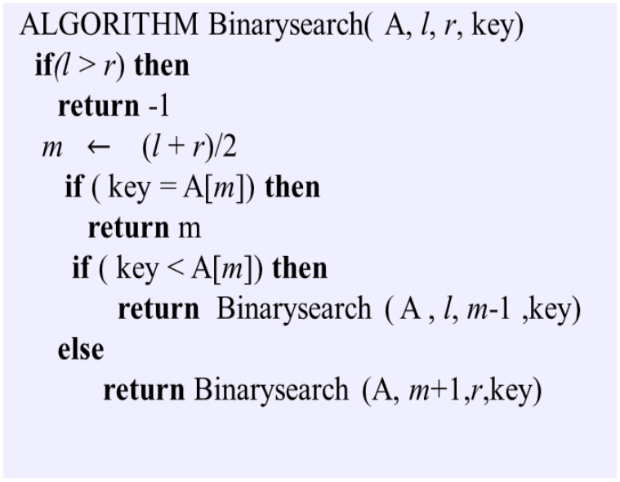
Binary Search: Recursive Algorithm

Slide 11
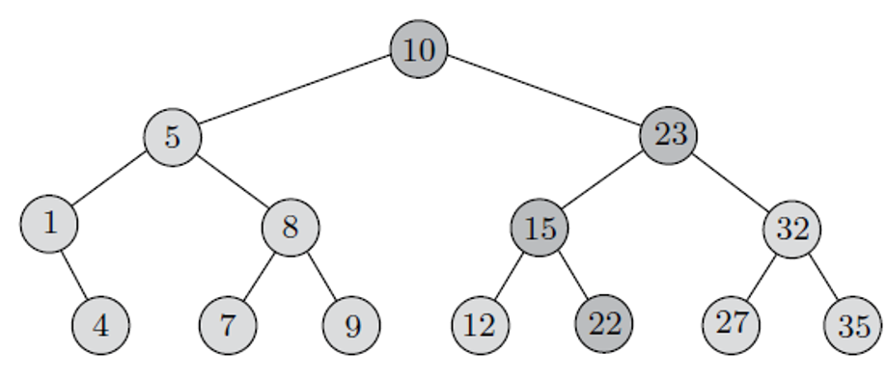
Binary Search Tree
Suppose that we want to search for x = 35

Slide 12
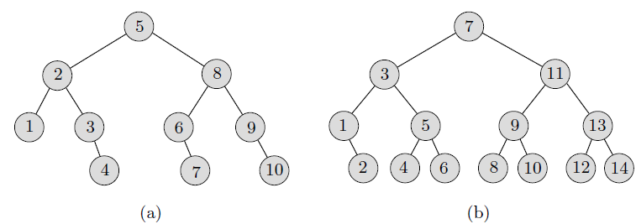
Binary Search Tree
the maximum number of comparisons in both trees is 4.
In general, the maximum number of comparisons is 1 plus the height of the corresponding BST

Slide 13
An Introduction
We have discussed various searching techniques
  Linear/Sequential Search
    Efficiency: O(n): Linear
  Binary Search
    Efficiency: O(logn): Logarithmic
  Binary Search Tree
    Efficiency: O(logn): Logarithmic
Problem Statement: How to store keys in an array so that we access keys in constant time i.e. O(1)
Solution: ???????

Slide 14
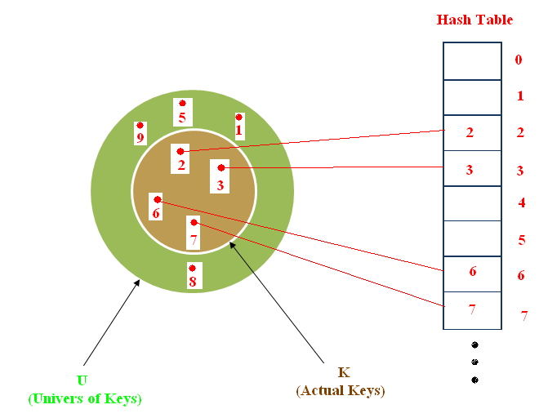
Solution
Solution : Direct –Address tables
IDEA: Suppose that the set of keys is K ⊆ {0,1, …, m–1}, and keys are distinct. Set up an array T[0 . . m–1] as :If value of key is i store that key at T[i]
Mathematically:
x if x ∈ K and key[x] = k
T[k] =
NIL otherwise.
Pictorially:

Slide 15
Solution
Pictorially:

Slide 16
Hashing
Benefits
insert: calculate place of storage, insert TableNode; (1)
find: calculate place of storage, retrieve entry; (1)
remove: calculate place of storage, set it to null; (1)
key
entry
4
10
All are constant time i.e.O(1) !
123

Slide 17
Drawbacks
Memory Wastage :The range of keys can be large
  18,446,744,073,709,551,616 different keys.
  To store these keys ,table size should be 744
  character strings (even larger!)

Slide 18
Other Solution
Is there any other solution?
Yes: ?
  IDEA:
    Convert the key into array index
    Store that key in array at index generated in above step
    for searching, convert the key into array index and get the key from array

Slide 19
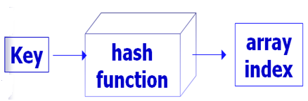
Implementation 6: Hashing
Hashing
How to convert key into array index?
Their place of storage is calculated using the key and a hash function
Let h be hash function
and k be the key then
array index =h(k)
Pictorially

Slide 20
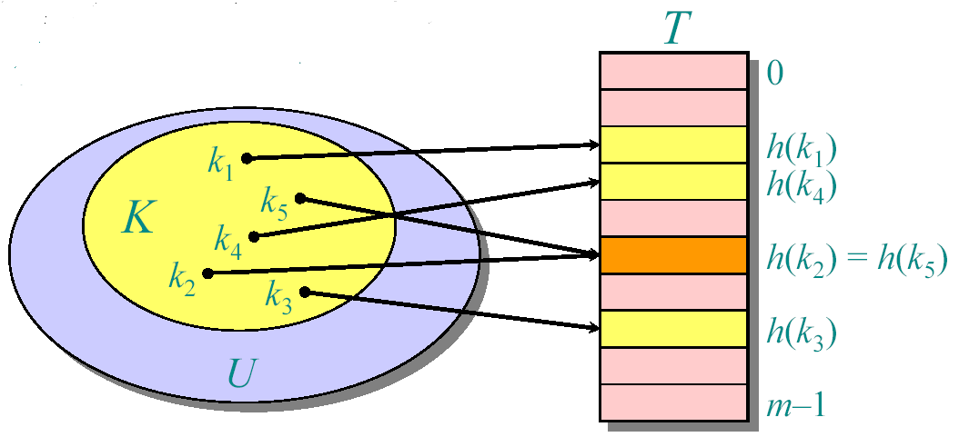
What is Hashing?
A technique that determines an index or location for storage of an item in a data structure
The hash function receives the search key
  Returns the index of an element in an array called the hash table
  The index is known as the hash index
Pictorially

Slide 21
Choosing a Hash function
What are the criteria for choosing good hash functions?
The principal criteria in choosing hash functions are:
  It should be easy to compute the index of the key
  It should distribute keys evenly
  A perfect hash function maps each search key into a different integer suitable as an index to the hash table
    It should minimize collision(should be one-to-one. i.e. distinct keys should be mapped to distinct indices)

Slide 22
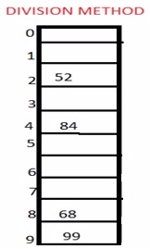
Types of Hash function
There are various types of hash function which are used to place the data in a hash table
Division method
  In this method, the hash function is dependent upon the remainder of a division.
  For example:-if the keys 52,68,99,84 is to be placed in a hash table and let us take the table size is 10.
  hashIndex= key% table size
2=52%10
8=68%10
9=99%10
4=84%10

Slide 23
Division Method
Assume all keys are integers, and define
h(k) = k mod m.
Where m is the size of hash table
Example:
Insert the numbers 10, 20, 30, 40, 50, 60 and 70 into a hash table. with TABLESIZE: 13
Assuming the Hash function:
h(key) = key mod TABLESIZE.
Solution:
 | 40 | 80 |  | 30 | 70 |  | 20 | 60 |  | 10 | 50
0 | 1 | 2 | 3 | 4 | 5 | 6 | 7 | 8 | 9 | 10 | 11 | 12

Slide 24
Division Method
What is the size of hash table (array)?
We use hash table of some fixed size m to hold the data. m is typically prime(why).
The choice of the size of a hash table, TABLESIZE, can affect the collision rate of a hash function
Insert the numbers 10, 20, 30, 40, 50, 60 and 70 into a hash table. with TABLESIZE= 10
  key%10= 0 for all keys. COLLISION(Pick m to be a prime.)
In general, to avoid situations like this, m should be a prime number.
0 | 1 | 2 | 3 | 4 | 5 | 6 | 7 | 8 | 9 | 10 | 11 | 12

Slide 25
Division Method
Insert the numbers 10, 20, 30, 40, 50, 60 and 70 into a hash table. with TABLESIZE= 15
It is obvious from the above examples that the way we select our TABLESIZE can affect the hashing. This choice depends on data sets but using prime numbers as TABLESIZE usually lead to less collisions.
Annoyance: Sometimes, making the table size a prime is inconvenient.
30 |  |  |  |  | 20 |  |  |  |  | 10
60 |  |  |  |  | 50 |  |  |  |  | 40
 |  |  |  |  | 80 |  |  |  |  | 70
0 | 1 | 2 | 3 | 4 | 5 | 6 | 7 | 8 | 9 | 10 | 11 | 12 | 13 | 14

Slide 26
Example
If the keys are strings the hash function is some function of the characters in the strings.
One possibility is to simply add the ASCII values of the characters:
⎛
length
−
1
⎞
=
⎜
∑
⎟
h
(
str
)
⎜
str
[
i
]
⎟
%
TableSize
⎝
⎠
i
=
0
Example
:
h
(
ABC
)
=
(
65
+
66
+
67
)%
TableSize

Slide 27
Suppose our hash function gave us the following values:
  hashCode("apple") = 5
  hashCode("watermelon") = 3
  hashCode("grapes") = 8
  hashCode("cantaloupe") = 7
  hashCode("kiwi") = 0
  hashCode("strawberry") = 9
  hashCode("mango") = 6
  hashCode("banana") = 2
0
1
2
3
4
5
6
7
8
9
kiwi
banana
watermelon
apple
mango
cantaloupe
grapes
strawberry

Slide 28
Finding the hash function
int hashCode( char* s )
{
int i, sum;
sum = 0;
for(i=0; i < strlen(s); i++ )
sum = sum + s[i]; // ascii value
return sum % TABLESIZE;
}

Slide 29
Example Hash Functions
Another possibility is to convert the string into some number in some arbitrary base b (b also might be a prime number):
⎛
length
−
1
⎞
=
⎜
∑
×
i
⎟
h
(
str
)
⎜
str
[
i
]
b
⎟
%
T
⎝
⎠
i
=
0
Example
:
h
(
ABC
)
=
(
65
b
0
+
66
b
1
+
67
b
2
)%
T

Slide 30
Types of Hash function
Mid square method
  In this method firstly key is squared and then mid part of the result is taken as the index.
  For example: consider that if we want to place a key 3101 and the size of table is 1000. So 3101*3101=9616201 i.e. h (3101) = 162 (middle 3 digit)

Slide 31
Types of Hash function
Digit folding method
  In this method the key is divided into separate parts and by using some simple operations these parts are combined to produce a hash key. For example: consider a record of 12465512 then it will be divided into parts i.e. 124, 655, 12. After dividing the parts combine these parts by adding it.
  H(key)=124+655+12
  = 791

Slide 32
Collision
When two values hash to the same array location, this is called a collision
Collisions are normally treated as “first come, first served”—the first value that hashes to the location gets it
We have to find something to do with the second and subsequent values that hash to this same location.

Slide 33
Collision
Suppose our hash function gave us the following values:
  hash("apple") = 5
  hash("watermelon") = 3
  hash("grapes") = 8
  hash("cantaloupe") = 7
  hash("kiwi") = 0
  hash("strawberry") = 9
  hash("mango") = 6
  hash("banana") = 2
0
1
2
3
4
5
6
7
8
9
kiwi
banana
watermelon
apple
mango
cantaloupe
hash("honeydew") = 6
grapes
strawberry
• Now what?

Slide 34
Collision Resolution Policies
Two classes:
  Open hashing, a.k.a. separate chaining
  Closed hashing, a.k.a. open addressing
Difference has to do with whether collisions are stored outside the table (open hashing) or whether collisions result in storing one of the records at another slot in the table (closed hashing)

Slide 35
Solution for Handling collisions
Solution #1: Search from there for an empty location
  Can stop searching when we find the value or an empty location.
  Search must be wrap-around at the end.

Slide 36
Solution for Handling collisions
Solution #2: Use a second hash function
  ...and a third, and a fourth, and a fifth, ...

Slide 37
Solution for Handling collisions
Solution #3: Use the array location as the header of a linked list of values that hash to this location

Slide 38
Solution 1: Open Addressing
This approach of handling collisions is called open addressing; it is also known as closed hashing.
More formally, cells at h₀(x), h₁(x), h₂(x), … are tried in succession where:
h_{i}(x) = (hash(x) + f(i)) mod TableSize,
with f(0) = 0.
The function, f, is the collision resolution strategy.

Slide 39
Linear Probing
We use f(i) = i, i.e., f is a linear function of i. Thus
location(x) = (hash(x) + i) mod TableSize
The collision resolution strategy is called linear probing because it scans the array sequentially (with wrap around) in search of an empty cell.

Slide 40
Linear Probing: insert
Suppose we want to add seagull to this hash table
Also suppose:
  hashCode(“seagull”) = 143
  table[143] is not empty
  table[143] != seagull
  table[144] is not empty
  table[144] != seagull
  table[145] is empty
Therefore, put seagull at location 145
. . .
141
142
143
144
145
146
147
148
. . .
robin
sparrow
hawk
seagull
bluejay
owl

Slide 41
Linear Probing: insert
Suppose you want to add hawk to this hash table
Also suppose
  hashCode(“hawk”) = 143
  table[143] is not empty
  table[143] != hawk
  table[144] is not empty
  table[144] == hawk
hawk is already in the table, so do nothing.
. . .
141
142
143
144
145
146
147
148
. . .
robin
sparrow
hawk
seagull
bluejay
owl

Slide 42
Linear Probing: insert
Suppose:
  You want to add cardinal to this hash table
  hashCode(“cardinal”) = 147
  The last location is 148
  147 and 148 are occupied
Solution:
  Treat the table as circular; after 148 comes 0
  Hence, cardinal goes in location 0 (or 1, or 2, or ...)
. . .
141
142
143
144
145
146
147
148
robin
sparrow
hawk
seagull
bluejay
owl

Slide 43
Linear Probing: find
Suppose we want to find hawk in this hash table
We proceed as follows:
  hashCode(“hawk”) = 143
  table[143] is not empty
  table[143] != hawk
  table[144] is not empty
  table[144] == hawk (found!)
We use the same procedure for looking things up in the table as we do for inserting them
. . .
141
142
143
144
145
146
147
148
. . .
robin
sparrow
hawk
seagull
bluejay
owl

Slide 44
Clustering
One problem with linear probing technique is the tendency to form “clusters”.
A cluster is a group of items not containing any open slots
The bigger a cluster gets, the more likely it is that new values will hash into the cluster, and make it ever bigger.
Clusters cause efficiency to degrade.

Slide 45
Quadratic Probing
Quadratic probing uses different formula:
  Use F(i) = i² to resolve collisions
  If hash function resolves to H and a search in cell H is inconclusive, try H + 1², H + 2², H + 3², …
Probe
array[hash(key)+1²], then
array[hash(key)+2²], then
array[hash(key)+3²], and so on
  Virtually eliminates primary clusters

Slide 46
Double Hashing
Double hashing uses the idea of applying a second hash function to key when a collision occurs.
Double hashing can be done using :
(hash1(key) + i * hash2(key)) % TABLE_SIZE
  Here hash1() and hash2() are hash functions and TABLE_SIZE is size of hash table.
    First hash function is typically:
    hash1(key) = key % TABLE_SIZE
    Popular second hash function is :
    hash2(key) = PRIME – (key % PRIME)
    where PRIME is a prime smaller than the TABLE_SIZE.

Slide 47
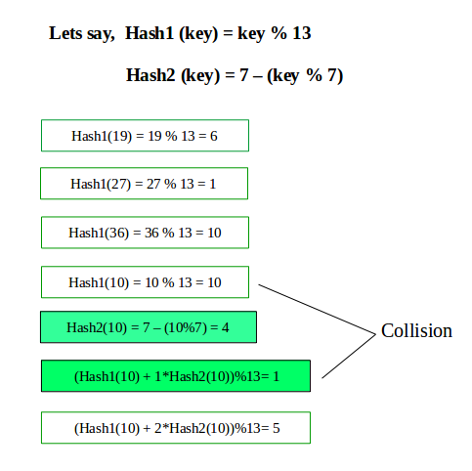
Double Hashing

Slide 48
Collision resolution: chaining
Use the array location as the header of a linked list of values that hash to this location
Each table position is a linked list
Add the keys and entries anywhere in the list (front easiest)
No need to change position!
key entry
key entry
4
key entry
key entry
10
key entry
123

Slide 49
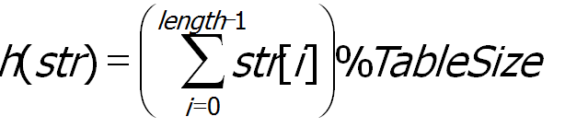
Collision resolution: chaining
Insert the keys into the hash table where hash function is defined as:
TableSize =13 and str[i]= position of word’s letters in the alphabet
A, FOOL, AND , HIS MONEY,ARE , SOON, PARTED
Start with the empty table.
First key is the word A; h(A)=1 mod 13=1, it will be stored in first cell .
Second key is word FOOL , it would be stored in ninth cell , since (6+15+15+12)=48 mod 13= 9 and so on .
………………………..

Slide 50
Collision resolution: chaining
The final result of this process is given below :
Keys | A | FOOL | AND | HIS | MONEY | ARE | SOON | PARTED
Hash addresses | 1 | 9 | 6 | 10 | 7 | 11 | 11 | 12
0 | 1 | 2 | 3 | 4 | 5 | 6 | 7 | 8 | 9 | 10 | 11 | 12
A
AND
MONEY
FOOL
HIS
ARE
PARTED
SOON

Slide 51
Chaining: find
First we will get the hash key value in hash table through hash function, then we will search the element in corresponding linked list.

Slide 52
Collision resolution: find
Suppose I want to find key SOON , I will find the hash address by using same hash function h(SOON)=11;
Since the list attached to cell 11 is not empty , we start searching the list , first compared to first key in the list , if not matched then second and so on …..
Find key =KID ?
0 | 1 | 2 | 3 | 4 | 5 | 6 | 7 | 8 | 9 | 10 | 11 | 12
A
AND
MONEY
FOOL
HIS
ARE
PARTED
SOON

Slide 53
Chaining: delete
Deletion contains first search operation then same as delete operation of linked list .

Slide 54
Analysis of chaining
Let n be the number of keys in the table, and
let m be the number of slots.
Define the load factor of hash table T to be
α= n/m =average number of keys per slot.
The load factor plays a crucial role in the efficiency of hashing .

Slide 55
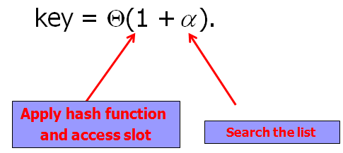

Chaining: Cost of searching
In general, the efficiency of the searching depends on the lengths of the linked list, which, in turn, depends on table size, as well as quality of hash function .
Expected time to search for a record with a given
key is
Expected search time is constant i.e Θ(1) if α= n/m =1 i.e. n=m

Slide 56
Collision resolution: chaining
Advantages over open addressing:
  Simpler insertion and removal
  Array size is not a limitation
Disadvantage
  Memory overhead is large if entries are small.
key entry
key entry
4
key entry
key entry
10
key entry
123
Notes:
End of Lecture 42.

Slide 57
Applications of Hashing
Compilers use hash tables to keep track of declared variables (symbol table).
A hash table can be used for on-line spelling checkers — if misspelling detection (rather than correction) is important, an entire dictionary can be hashed and words checked in constant time.
Notes:
Start of lecture 43 after animation.

Slide 58
Applications of Hashing
Game playing programs use hash tables to store seen positions, thereby saving computation time if the position is encountered again.
Hash functions can be used to quickly check for inequality — if two elements hash to different values they must be different.

Slide 59
When is hashing suitable?
Hash tables are very good if there is a need for many searches in a reasonably stable table.
Hash tables are not so good if there are many insertions and deletions, or if table traversals are needed — in this case, AVL trees are better.
Also, hashing is very slow for any operations which require the entries to be sorted
  e.g. Find the minimum key

Slide 60
Advantages and Disadvantages of Hashing
Advantage of Hashing
  Insertion, Deletion and Retrieval can be done in
  constant average time
Disadvantage of Hashing
Can require a lot more extra storage than other searching methods.
Ordering of data is not supported. For example, the following operations are not supported:
  finding the minimum value from data set.
  finding the maximum value from data set.
  printing the data in sorted order.

Slide 61
Assignment Problems

Slide 62
Try it out !
Single-Source Shortest Path (SSSP)
Try: For the inputs 50,10,59,75,21,18 and hash function
h(k) = k%11
Construct the open and closed hash table
Find the largest number of key comparison in a successful search for both tables
Find the average number of key comparison in a successful search for both tables

Slide 63
Try it out !
Try: Given input 4371,1323,6173,4199,4344,9679,1989
And a hash function h(k) = k%10
Show the resulting
Separate changing hash table
Open addressing hash table using linear probing
Open addressing hash table using quadratic probing
Open addressing hash table with second hash function h₂(k) = 7 – (k %7)

Slide 64
Try it out !
Try: Fill in the following table with the average case efficiency
 | Unordered array | Ordered array | Binary Search Tree | Separate hashing | Linear Probing
Search
Insertion
deletion

Slide 65
Try it out !
Try: Explain how hashing can be applied to check whether all elements of a list are distinct. What is the time efficiency of this application?
Point to remember:
1. The hashing is an algorithmic procedure and a methodology. It is not a new data structure.
2. Hash function is a mathematical function that will return an array index.
3. The table that store the keys at hash index is called Hash table

